Slide 1






Computer Algorithm
Complexity Classes
Presented by:​
🔹Prottoy Sarker
(ID: 241311062)​
Presented by:​
🔹Abdullah Al Mahfuz
(ID:241311058)​

Slide 2


Introduction
🔹 What is Complexity?
•Complexity shows how difficult a problem is for a computer.
•It measures how much time and memory an algorithm needs to solve a problem.
Types of Complexity
There are two main types:
Time complexity (how long an algorithm takes to run)
space complexity (how much memory it needs)

Slide 3

Asymptotic Notations
Symbol Meaning:
Used For:
O (Big O) Upper bound Worst case
Ω (Omega) Lower bound Best case
Θ (Theta) Tight bound Average case
Example: Loop from 1 to n → O(n), Ω(n), Θ(n)

Slide 4
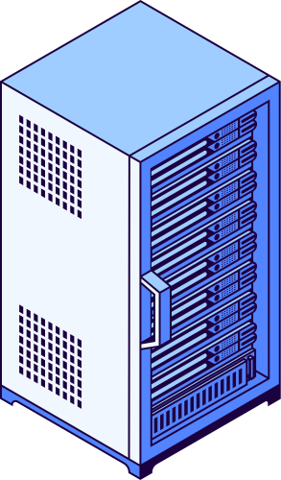

What Are Complexity Classes?
Points:
Complexity classes group problems by how difficult they are to solve.
They show which problems computers can solve efficiently and which are too
hard.
Mainly based on time complexity using polynomial time as a limit of efficiency.
Example Question:
Can we solve this problem fast (like n² or n³) — or only very slowly (like 2ⁿ)?

Slide 5
Complexity Classes
P
Problems solvable quickly (in polynomial time)
Sorting, Shortest Path
Easy to solve & verify
NP
Problems verifiable quickly, but may take long to solve
Sudoku, Subset Sum
Hard to solve, easy to check
NP-Complete
Hardest problems in NP — if one solved quickly, all NP can be
Traveling Salesman, 3-SAT
“Benchmark” for hardness
NP-Hard
At least as hard as NP-Complete, not necessarily in NP
Halting Problem, Optimization problems
May not even be checkable

Slide 6

Relation Between Complexity Classes
P ⊆ NP: Every problem solvable quickly can also be verified quickly.
NP-Hard
NP-Complete: The toughest problems inside NP.
NP
Complete
NP-Hard: At least as hard as NP-Complete (may not even be verifiable).
NP
P
P ⊆ NP ⊆ NP-Complete ⊆ NP-Hard

Slide 7

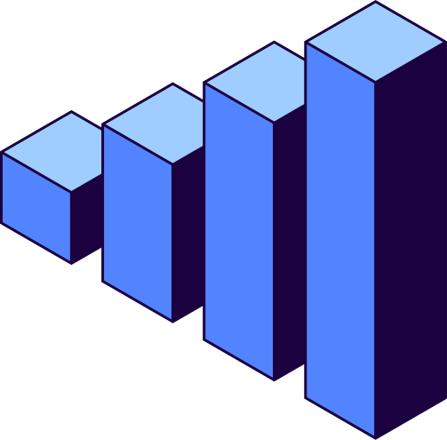

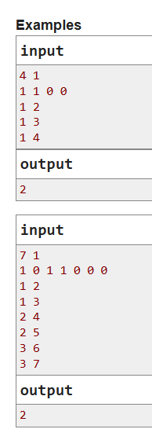

Complexity classes problem (NP)
C. Kefa and Park
Kefa decided to celebrate his first big salary by going to the restaurant.
He lives by an unusual park. The park is a rooted tree consisting of n vertices with the root at vertex 1. Vertex 1 also contains Kefa's house. Unfortunaely for our hero, the park also contains cats. Kefa has already found out what are the vertices with cats in them.
The leaf vertices of the park contain restaurants. Kefa wants to choose a restaurant where he will go, but unfortunately he is very afraid of cats, so there is no way he will go to the restaurant if the path from the restaurant to his house contains more than m consecutive vertices with cats.
Your task is to help Kefa count the number of restaurants where he can go.
Input
The first line contains two integers, n and m (2 ≤ n ≤ 105, 1 ≤ m ≤ n) — the number of vertices of the tree and the maximum number of consecutive vertices with cats that is still ok for Kefa.
The second line contains n integers a1, a2, ..., an, where each ai either equals to 0 (then vertex i has no cat), or equals to 1 (then vertex i has a cat).
Next n - 1 lines contains the edges of the tree in the format "xi yi" (without the quotes) (1 ≤ xi, yi ≤ n, xi ≠ yi), where xi and yi are the vertices of the tree, connected by an edge.
It is guaranteed that the given set of edges specifies a tree.
Output
A single integer — the number of distinct leaves of a tree the path to which from Kefa's home contains at most m consecutive vertices with cats.
https://codeforces.com/problemset/problem/580/C

Slide 8
Example discasion
Examples 1:
Input
4 1
1 1 0 0
1 2
1 3
1 4
Output
2
Examples 2:
Input
7 1
1 0 1 1 0 0 0
1 2
1 3
2 4
2 5
3 6
3 7
Output
2
1
1
1
1
3
2
3
2
3
4
2
4
4
5
6
7
https://codeforces.com/problemset/problem/580/C

Slide 9

Complexity Analysis:
Time Complexity:
Space Complexity:
•Building Tree (Adjacency List): O(n)
•DFS Traversal: Each node & edge visited once → O(n)
•Overall: ✅ O(n)
🔹 Efficient for n ≤ 10⁵
🔹 Each vertex processed once
•Adjacency List: O(n)
•DFS Recursion Stack: O(h) (≤ O(n))
•Cat Array & Other Variables: O(n)
•Overall: ✅ O(n)
🔹 Linear space usage
🔹 Depends on tree height
•

Slide 10

Studio Shodwe
Thank You!
For listening us
References:
"M. Sipser, Introduction to the Theory of Computation, 3rd Ed., 2012"
"S. Arora & B. Barak, Computational Complexity: A Modern Approach, 2009"

